Slide 1
1.7 Linear Independence

Slide 2
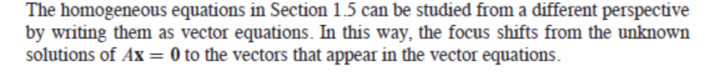
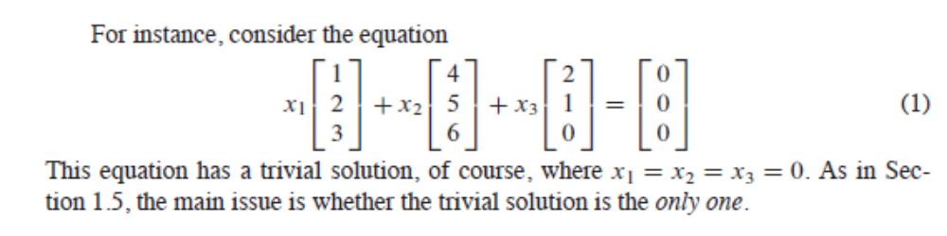

Slide 3
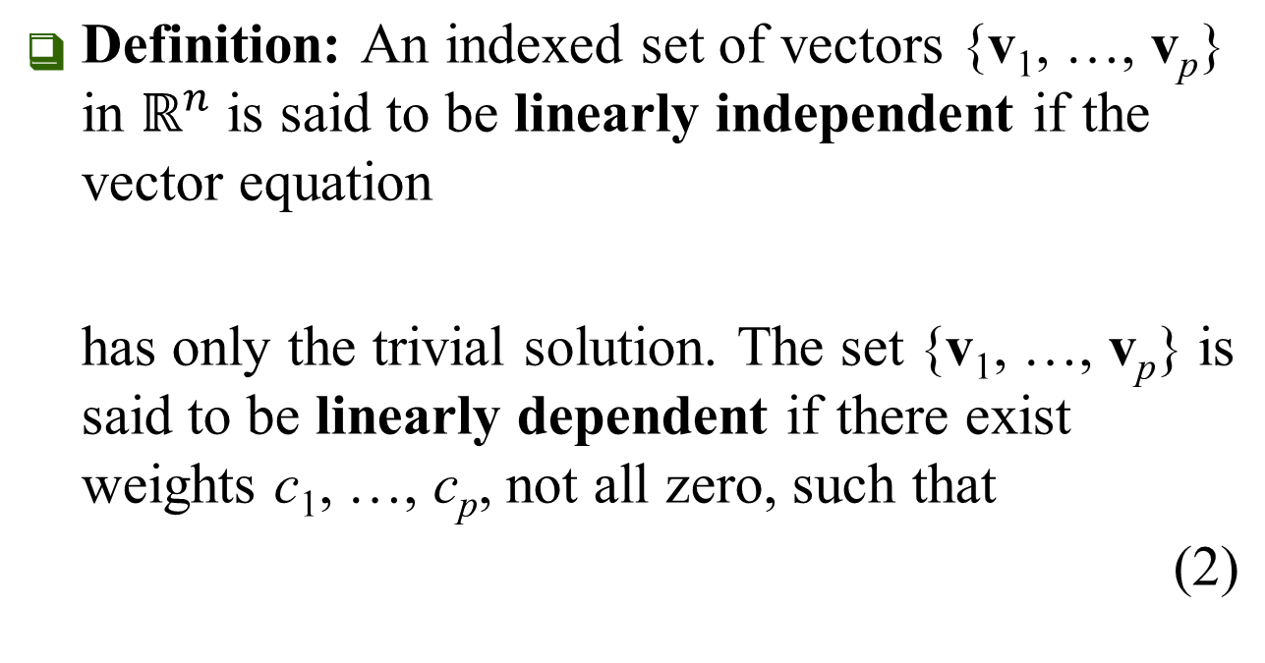
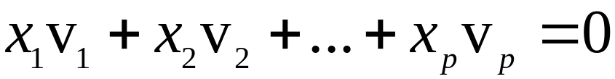
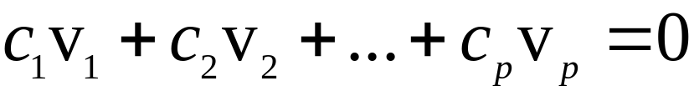
LINEAR INDEPENDENCE
Equation (2) is called a linear dependence relation among v₁, …, v_{p} when the weights are not all zero.

Slide 4
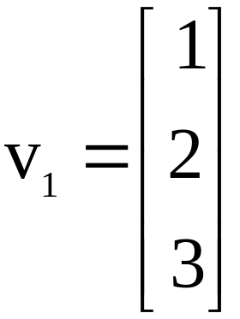
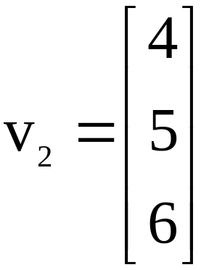
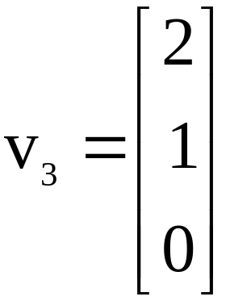
Example 1: Let , , and .
Determine if the set {v₁, v₂, v₃} is linearly independent.
If possible, find a linear dependence relation among v₁, v₂, and v₃.
Solution: We must determine if there is a nontrivial solution of the equation on the previous slide.

Slide 5
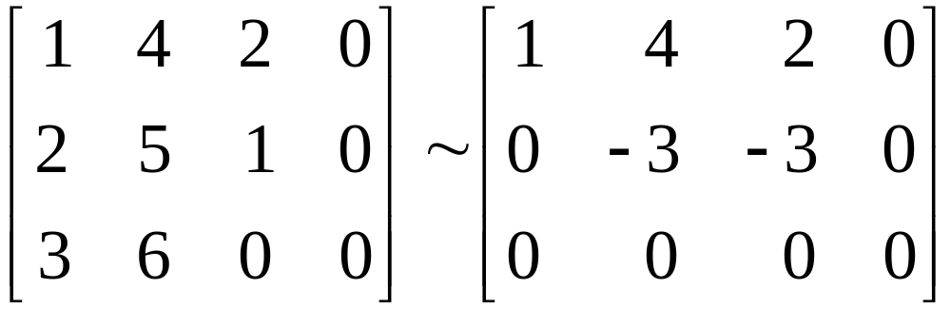
Row operations on the associated augmented matrix show that
.
x₁ and x₂ are basic variables, and x₃ is free.
Each nonzero value of x₃ determines a nontrivial solution of (1).
Hence, v₁, v₂, v₃ are linearly dependent.
~

Slide 6
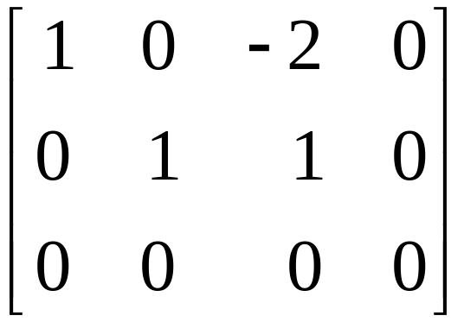
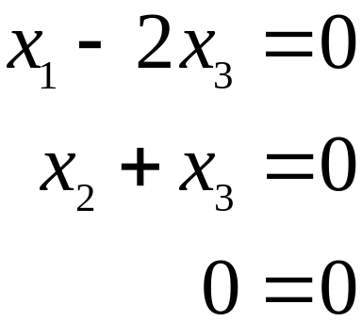





To find a linear dependence relation among v₁, v₂, and v₃, completely row reduce the augmented matrix and write the new system:
Thus, , , and x₃ is free.
Choose any nonzero value for x₃—say, .
Then and .

Slide 7
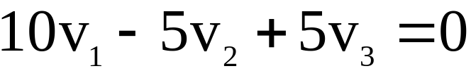
Substitute these values into equation (1) and obtain the equation below.
This is one (out of infinitely many) possible linear dependence relations among v₁, v₂, and v₃.

Slide 8
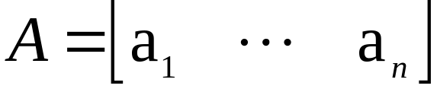

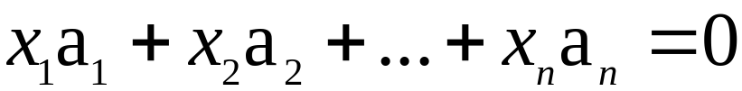
Suppose that we begin with a matrix
instead of a set of vectors.
The matrix equation can be written as
.
Each linear dependence relation among the columns of A corresponds to a nontrivial solution of .
The columns of matrix A are linearly independent if and only if the equation has only the trivial solution.

Slide 9
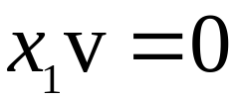

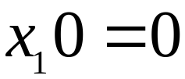
SETS OF ONE VECTOR
A set containing only one vector – say, v – is linearly independent if and only if v is not the zero vector.
This is because the vector equation has only the trivial solution when .
The zero vector is linearly dependent because has many nontrivial solutions.

Slide 10
SETS OF TWO VECTORS
A set of two vectors {v₁, v₂} is linearly dependent if at least one of the vectors is a multiple of the other.
The set is linearly independent if and only if neither of the vectors is a multiple of the other.

Slide 11
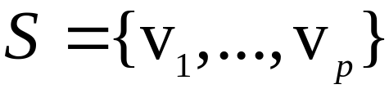
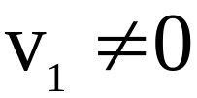

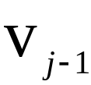
SETS OF TWO OR MORE VECTORS
THEOREM 7
Characterization of Linearly Dependent Sets
An indexed set of two or more vectors is linearly dependent if and only if at least one of the vectors in S is a linear combination of the others. In fact, if S is linearly dependent and , then some v_{j} (with ) is a linear combination of the preceding vectors, v₁, …, .

Slide 12

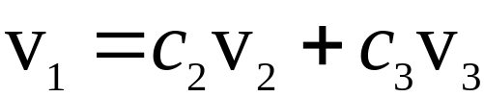
Proof: If some v_{j} in S equals a linear combination of the other vectors, then v_{j} can be subtracted from both sides of the equation, producing a linear dependence relation with a nonzero weight on v_{j}.
[For instance, if , then
.]
Thus S is linearly dependent.
Conversely, suppose S is linearly dependent.
If v₁ is zero, then it is a (trivial) linear combination of the other vectors in S.

Slide 13
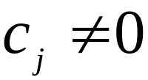

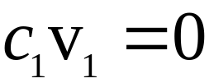
Otherwise, , and there exist weights c₁, …, c_{p}, not all zero, such that
.
Let j be the largest subscript for which .
If , then , which is impossible because
.

Slide 14
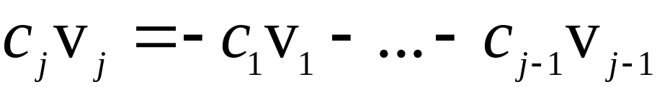
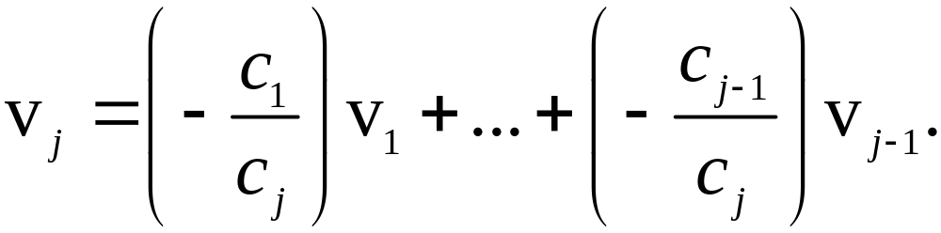
Slide 1.7- <number>
© 2016 Pearson Education, Ltd.
So , and

Slide 15
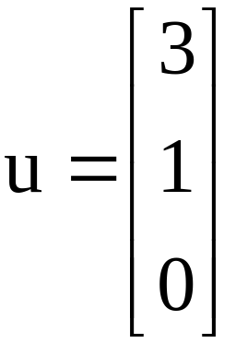
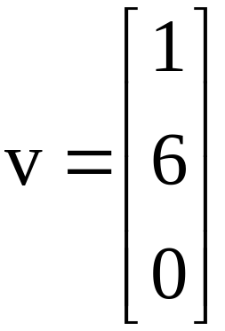
Theorem 7 does not say that every vector in a linearly dependent set is a linear combination of the preceding vectors.
A vector in a linearly dependent set may fail to be a linear combination of the other vectors.
Example 4: Let and . Describe the
set spanned by u and v, and explain why a vector w is in Span {u, v} if and only if {u, v, w} is linearly dependent.

Slide 16
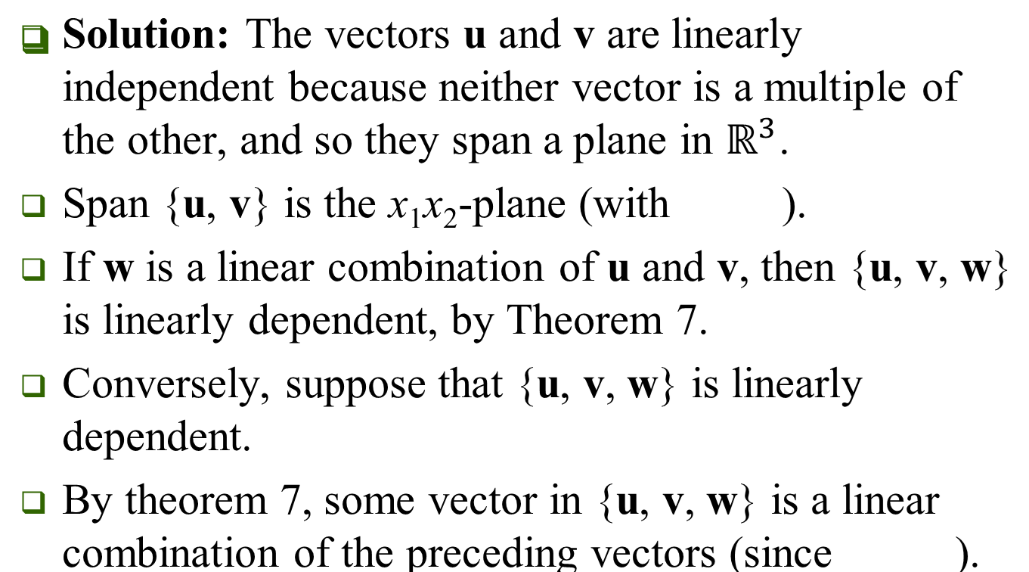



Slide 17
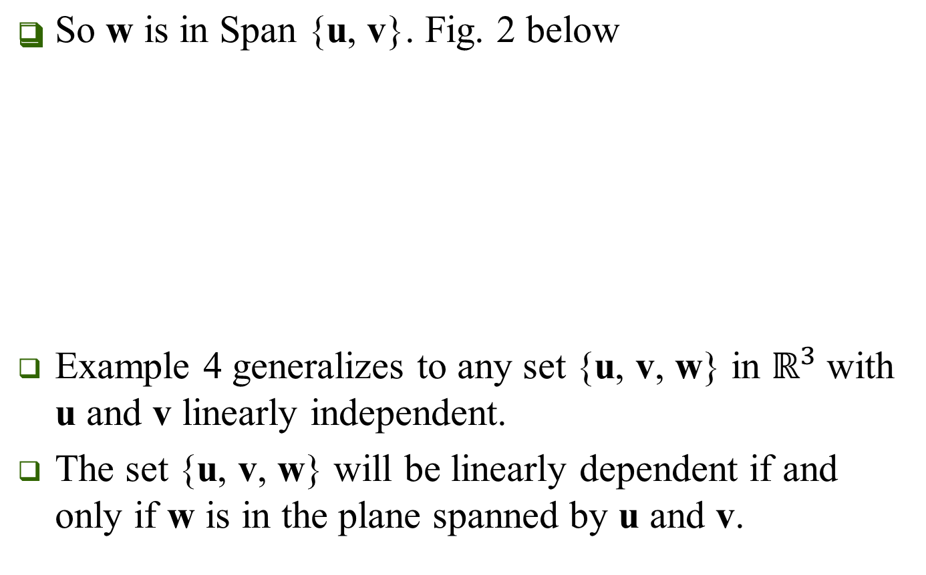
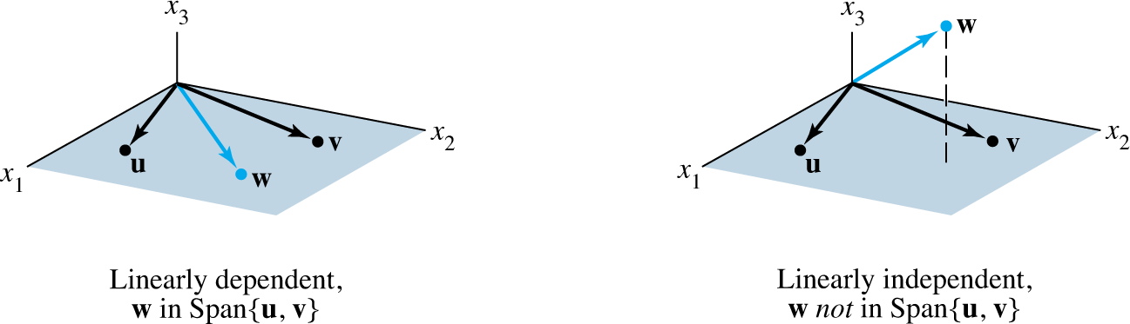

Slide 18
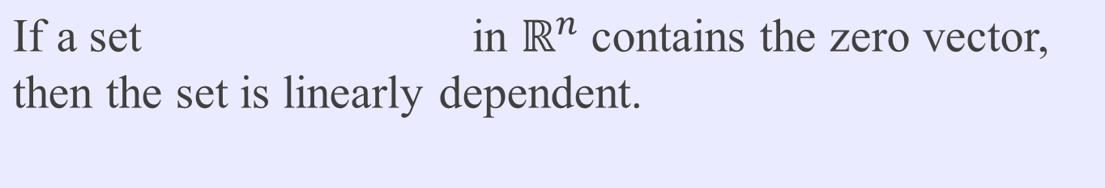
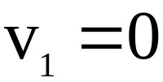
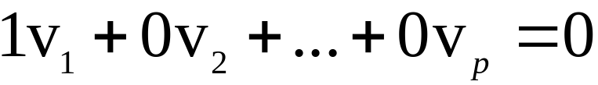
THEOREM 9
Proof: By renumbering the vectors, we may suppose
.
Then the equation shows that S in linearly dependent.

Slide 19
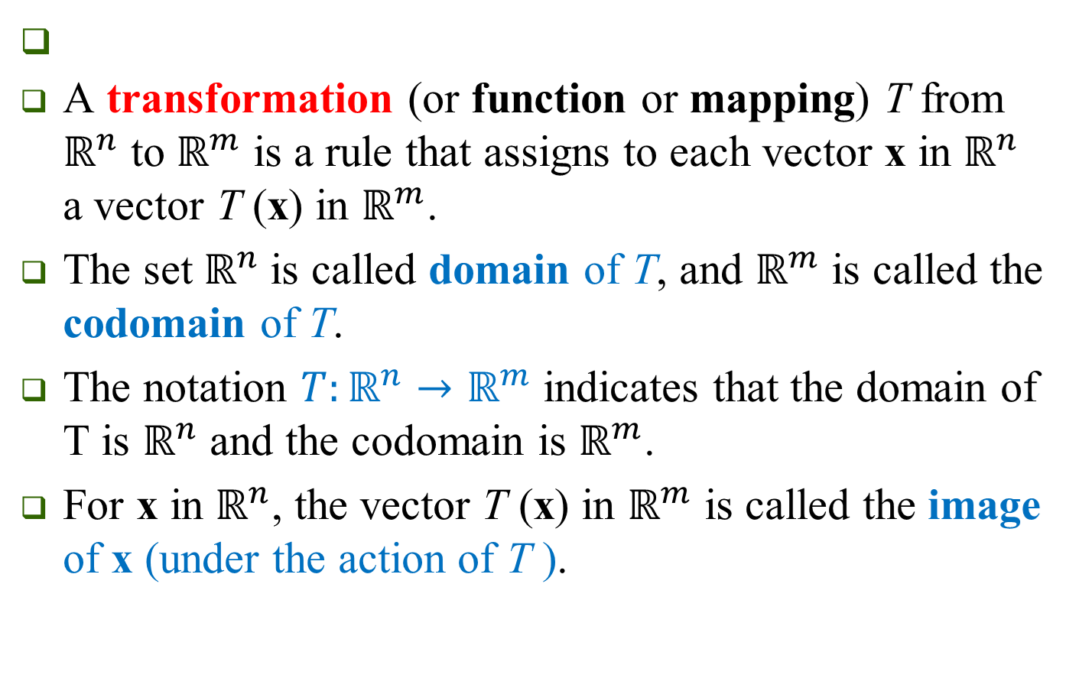
LINEAR TRANSFORMATIONS (Section 1.8)
Slide 6- <number>

Slide 20

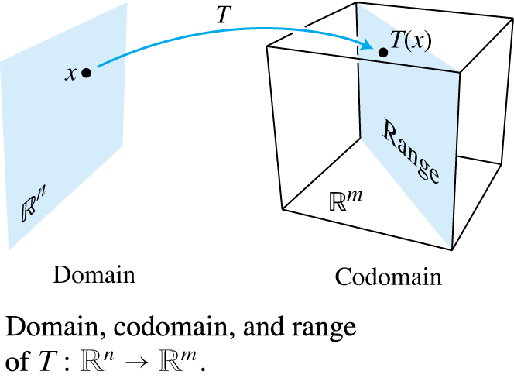
The set of all images T (x) is called the range of T.
Slide 6 - <number>

Slide 21
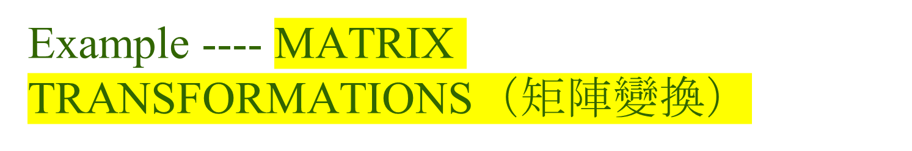
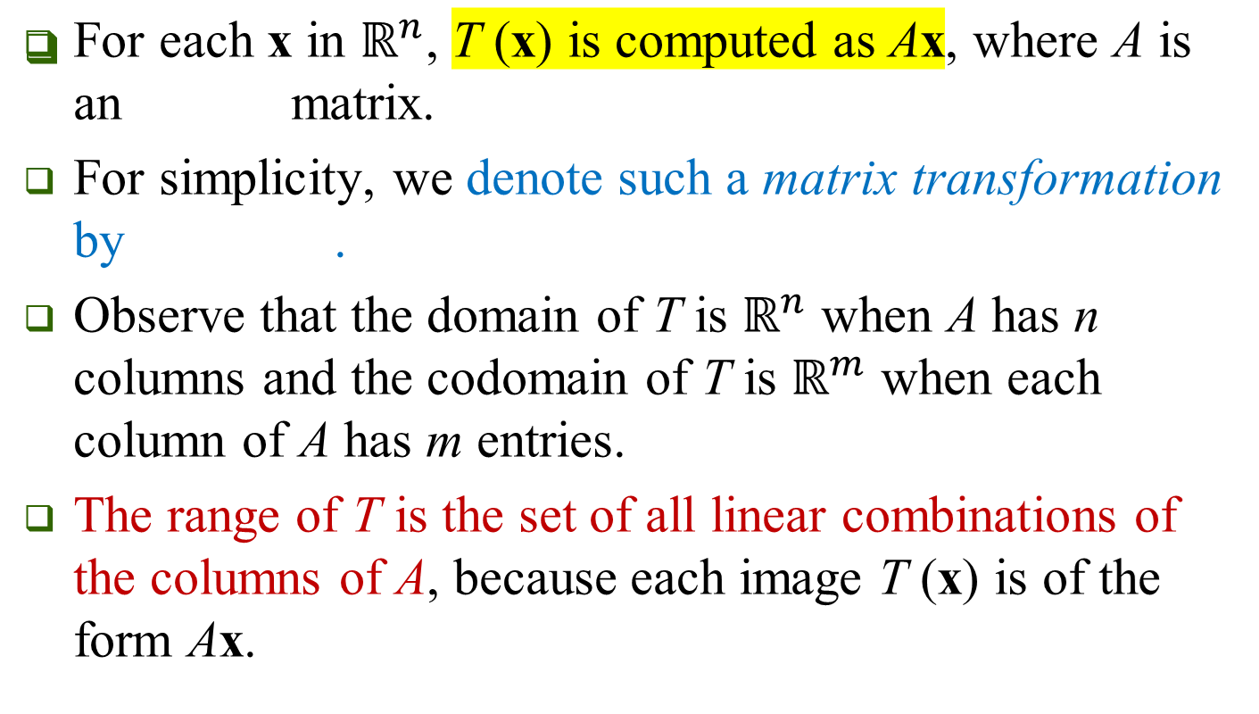


Slide 6- <number>

Slide 22
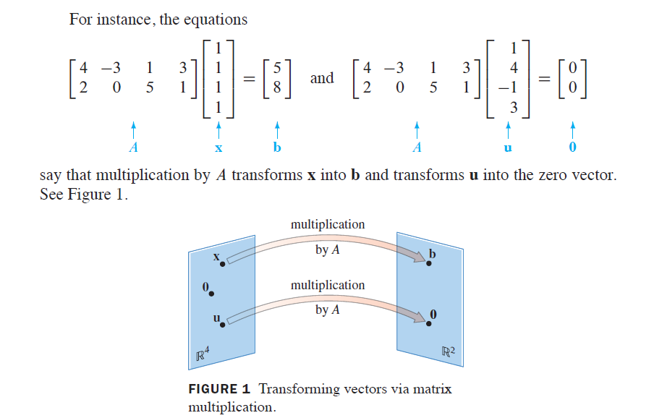
Slide 6 - <number>

Slide 23
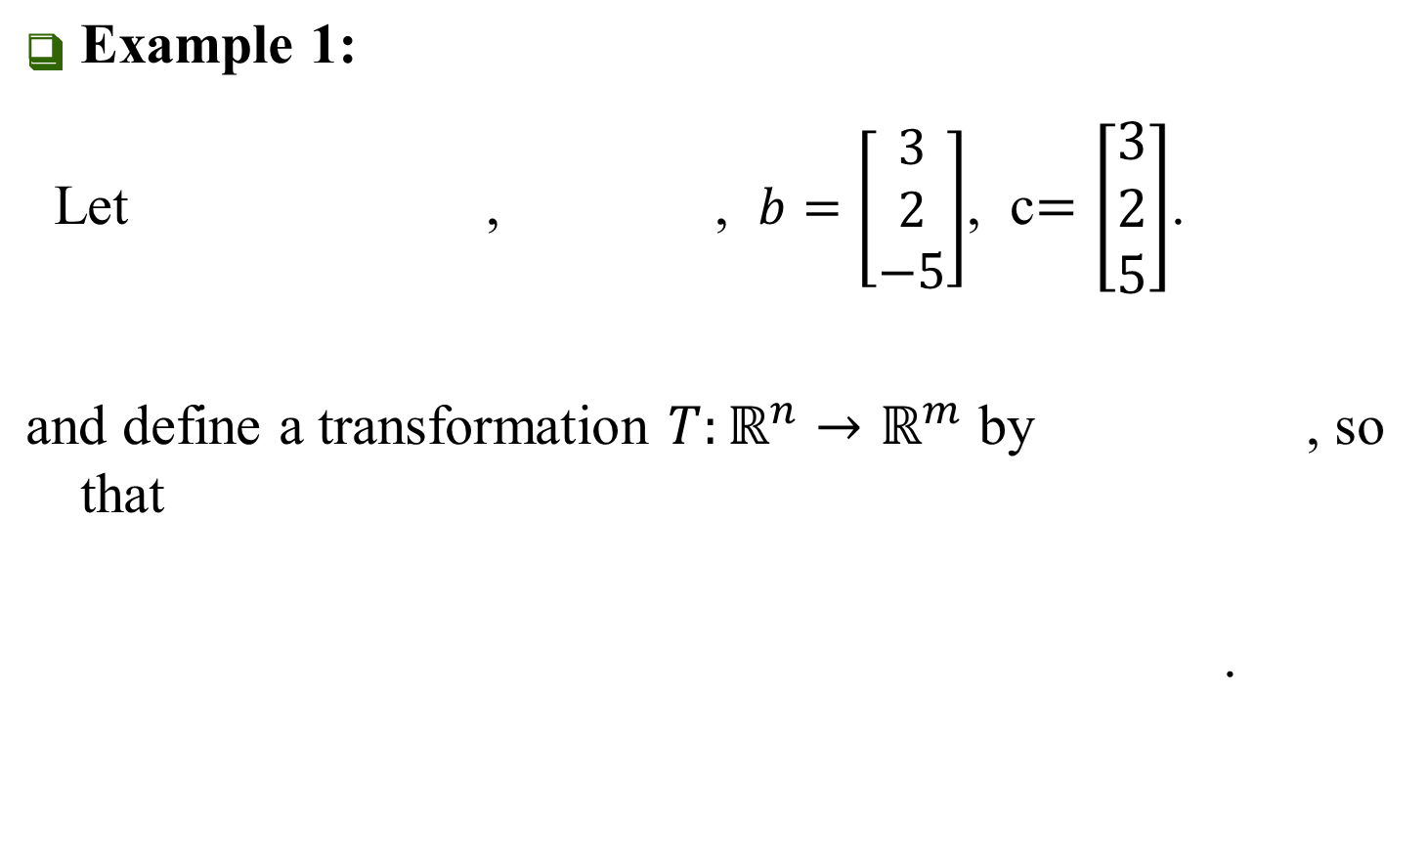
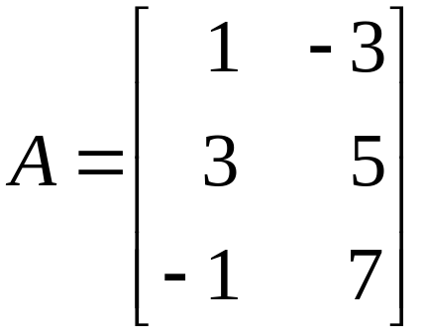
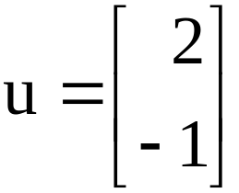

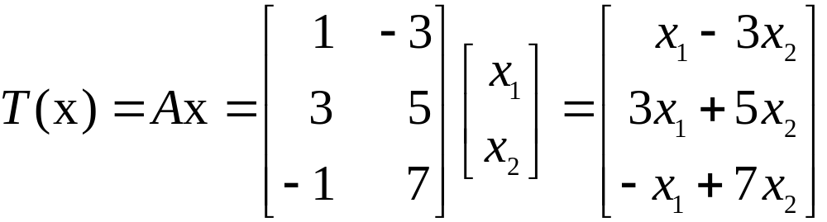
MATRIX TRANSFORMATIONS
Slide 6- <number>

Slide 24
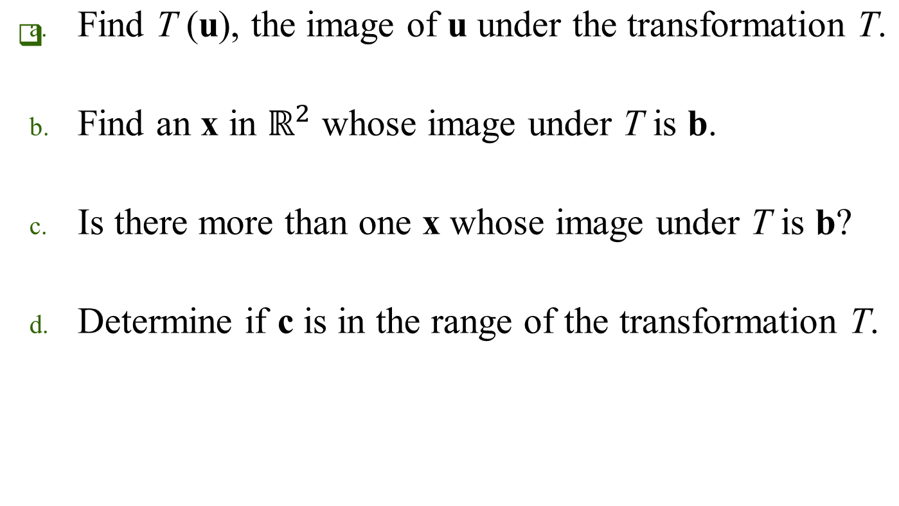
MATRIX TRANSFORMATIONS
Slide 6- <number>

Slide 25
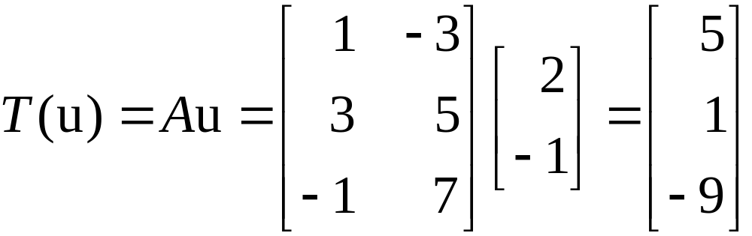


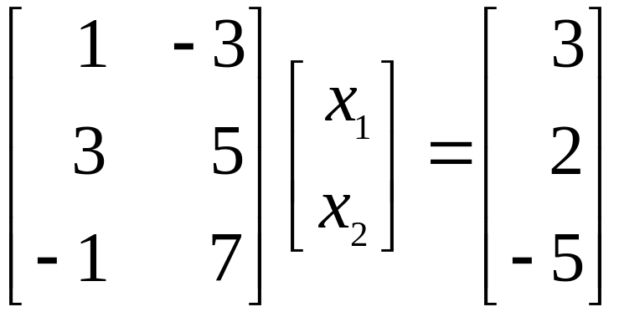
MATRIX TRANSFORMATIONS
Solution:
Compute
    .
Solve for x. That is, solve , or
    (1)
Slide 6- <number>

Slide 26
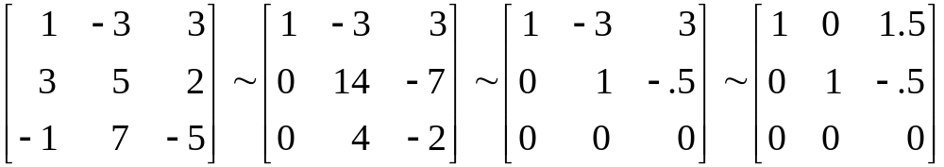
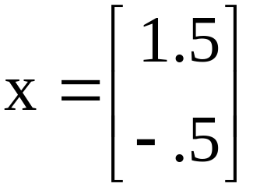
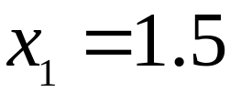
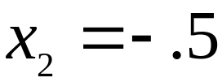
MATRIX TRANSFORMATIONS
Row reduce the augmented matrix:
(2)
Hence , , and .
The image of this x under T is the given vector b.
~
~
~
Slide 6- <number>

Slide 27
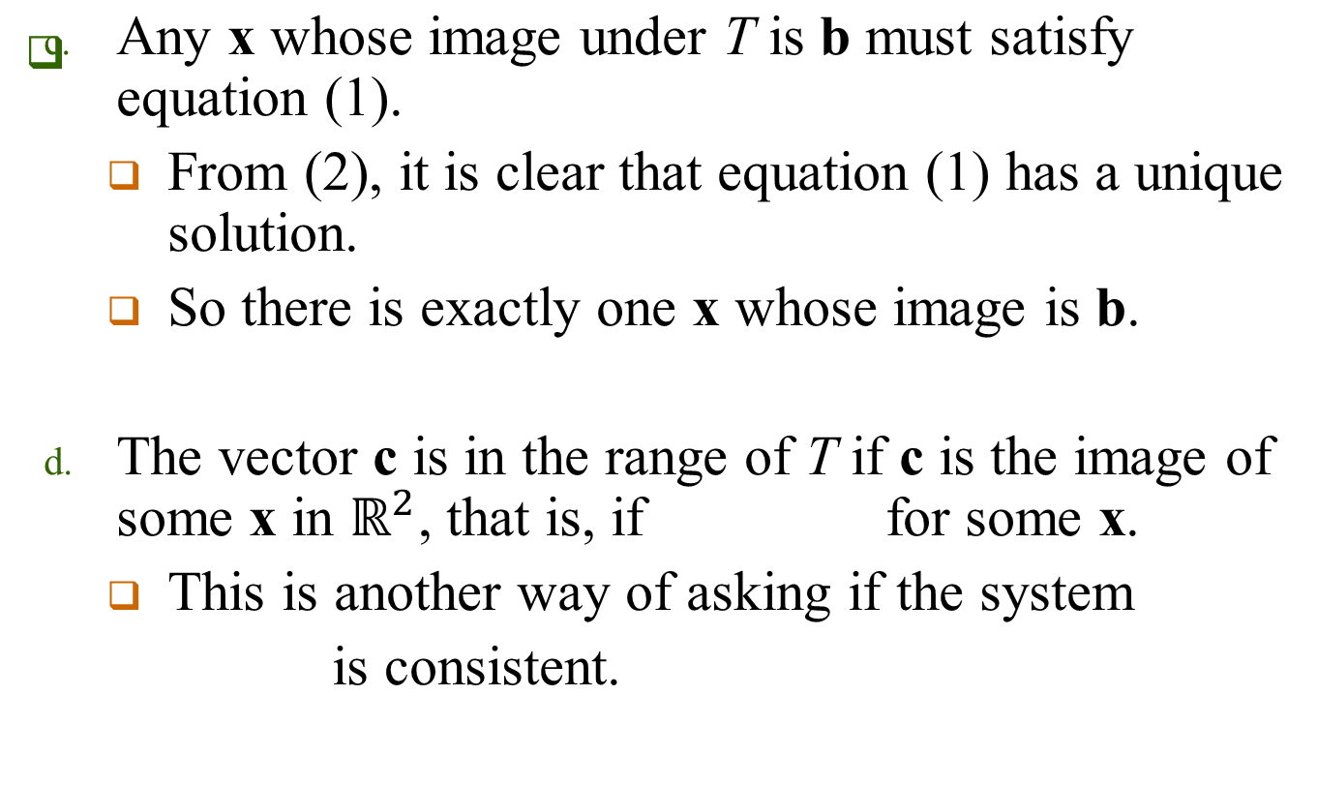


MATRIX TRANSFORMATIONS
Slide 6- <number>

Slide 28
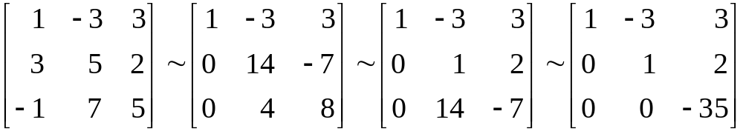

MATRIX TRANSFORMATIONS
      To find the answer, row reduce the augmented matrix:
      The third equation, , shows that the system is inconsistent.
      So c is not in the range of T.
~
~
~
Slide 6- <number>

Slide 29

Four Basic Questions about a transformation.
Slide 6 - <number>

Slide 30





SHEAR TRANSFORMATION（剪切變換）--- an example of matrix transformation
Slide 6- <number>

Slide 31




SHEAR TRANSFORMATION
The key idea is to show that T maps line segments onto line segments and then to check that the corners of the square map onto the vertices of the parallelogram.
For instance, the image of the point is
,
and the image of is .
T deforms the square as if the top of the square were pushed to the right while the base is held fixed.
Slide 6- <number>

Slide 32



LINEAR TRANSFORMATIONS
Definition: A transformation (or mapping) T is linear if:
    for all u, v in the domain of T;
    for all scalars c and all u in the domain of T.
Slide 6- <number>

Slide 33



LINEAR TRANSFORMATIONS
Slide 6- <number>

Slide 34




LINEAR TRANSFORMATIONS
Slide 6- <number>

Slide 35
LINEAR TRANSFORMATIONS
Repeated application of (4) produces a useful generalization:
(5)
In engineering and physics, (5) is referred to as a superposition principle（疊加原理）.
Slide 6- <number>

Slide 36




LINEAR TRANSFORMATIONS
Slide 6- <number>

Slide 37


Example: Given matrix of a matrix transformation, give the geometric description of the transformation.
Slide 6 - <number>

Slide 38

Question:
Given a geometric description of a linear transformation,
how to describe a linear transformation?
(how to give an explicit function relationship between x and y)

Slide 39




Slide 40


THE MATRIX OF A LINEAR TRANSFORMATION(Section 1.9)
(3)
Slide 6 - <number>

Slide 41


THE MATRIX OF A LINEAR TRANSFORMATION
Slide 6 - <number>

Slide 42

THE MATRIX OF A LINEAR TRANSFORMATION
Slide 6 - <number>

Slide 43


THE MATRIX OF A LINEAR TRANSFORMATION
Slide 6 - <number>

Slide 44


Tables 1-4 illustrate other common geometric linear transformations of the plane.
Slide 6 - <number>

Slide 45

EXISTENCE AND UNIQUENESS QUESTIONS
Table 1 continued:

Slide 46

EXISTENCE AND UNIQUENESS QUESTIONS
Table 1 continued:
Slide 6 - <number>

Slide 47

EXISTENCE AND UNIQUENESS QUESTIONS
Slide 6 - <number>

Slide 48

EXISTENCE AND UNIQUENESS QUESTIONS
Slide 6 - <number>

Slide 49

EXISTENCE AND UNIQUENESS QUESTIONS
Slide 6 - <number>

Slide 50

EXISTENCE AND UNIQUENESS QUESTIONS
Slide 6 - <number>

Slide 51


EXISTENCE AND UNIQUENESS QUESTIONS
Slide 6 - <number>

Slide 52

EXISTENCE AND UNIQUENESS QUESTIONS
Slide 6 - <number>

Slide 53

EXISTENCE AND UNIQUENESS QUESTIONS
Slide 6 - <number>

Slide 54

KERNEL AND RANGE OF A LINEAR TRANSFORMATION
Slide 6 - <number>

Slide 55
Glossary
Square matrix 方阵
(Row) Column Vector (行)列向量
Parallelogram rule 平行四边形法则
Scalar multiplication 数乘
Linear combination 线性组合
Parametric vector form 参数向量形式
(Non)Homogeneous (非)齐次的
(Non)Trivial solution (非)平凡解

